Slide 1
Advanced Computational Environments and Data Analytics
Task |  | R&D Area
1.1 |  | Data Management
1.2 |  | User Interface and Search
1.3 |  | Hardware & Network
1.4 |  | Data Transfer
1.5 |  | Installation (Containerized)
1.6 |  | Authentication & Authorization
1.7 |  | Federation
1.8 |  | Quality Control & Assurance
1.9 |  | Replication
1.10 |  | Distributed Search
1.11 |  | Metrics
1.12 |  | User Notification
1.13 |  | Long-tail Publication
1.14 |  | Distributed Computation
1.15 |  | Data Citation
2.1 |  | Provenance Capture
2.2 |  | Workflow
2.3 |  | Dynamic Resources
2.4 |  | In situ Analysis
2.5 |  | Machine Learning
2.6 |  | UQ
2.7 |  | Analytical Modeling
2.8 |  | Mobile Apps
Current capability status:
 | Usable
 | Prototype
 | Research activity
Charles Doutriaux
Lawrence Livermore National Laboratory
2017 Triennial Project Review, Potomac, MD
June 8 – 9, 2017
This work was performed under the auspices of the U.S. Department of Energy by Lawrence Livermore National Laboratory under Contract DEAC52-07NA27344.

Slide 2
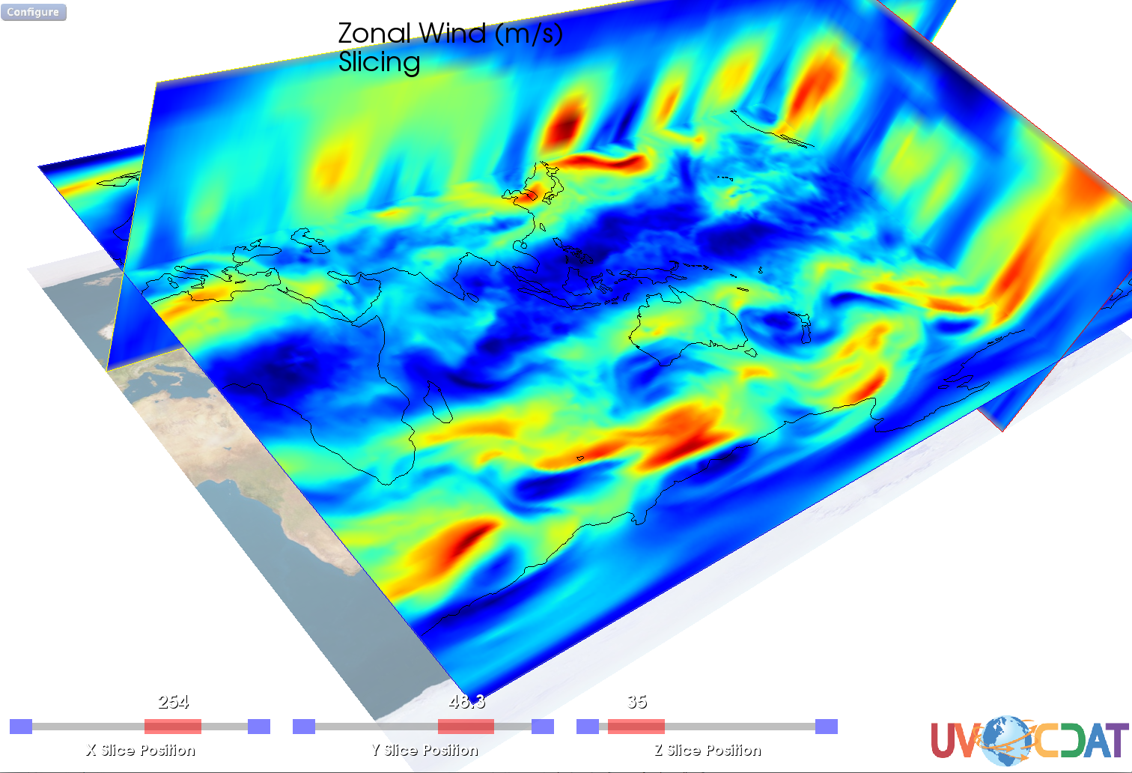

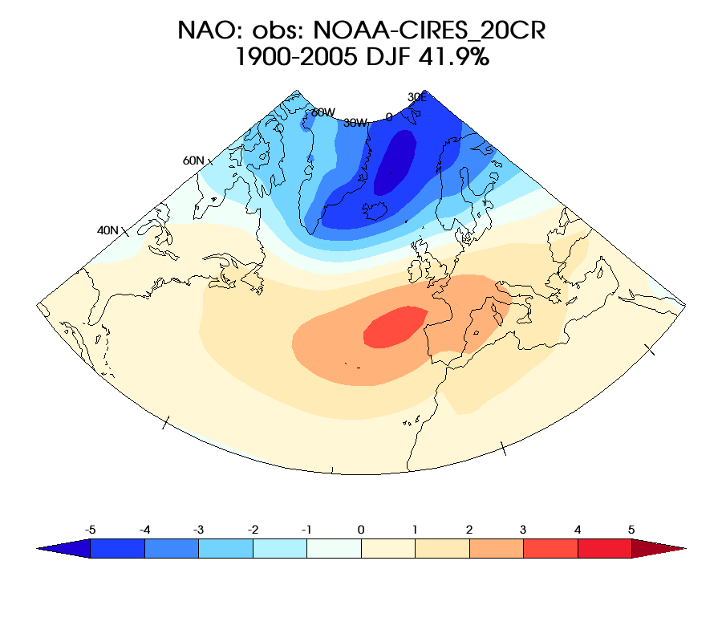
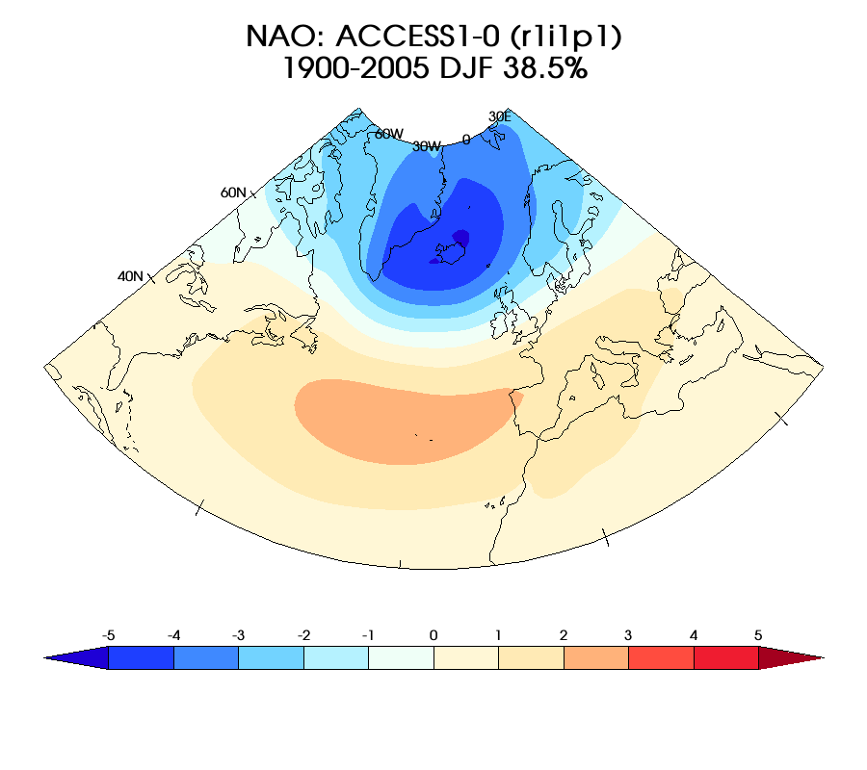
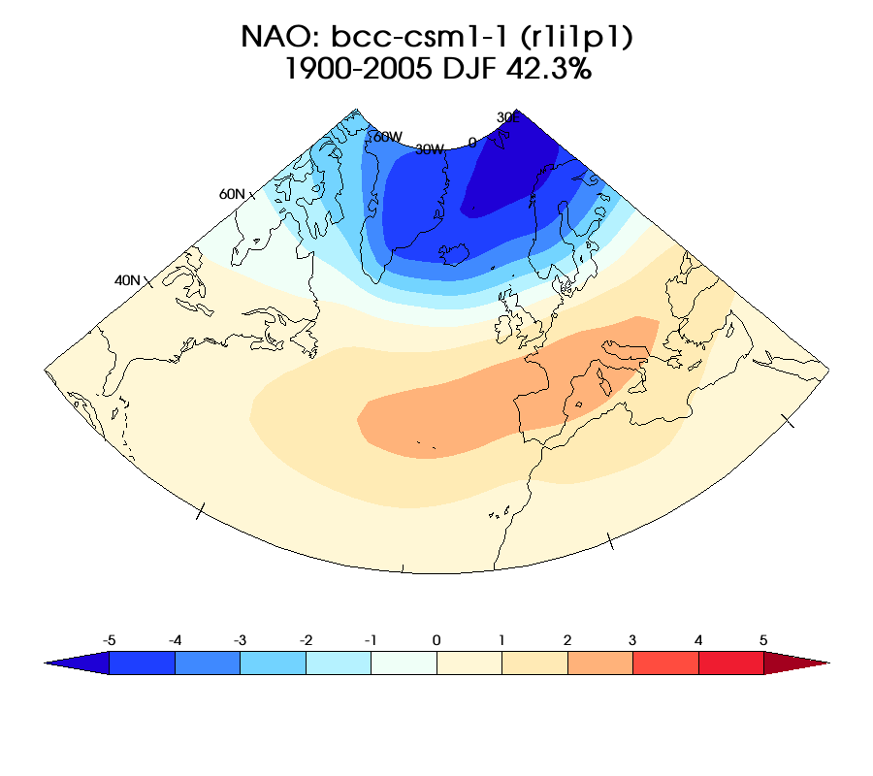
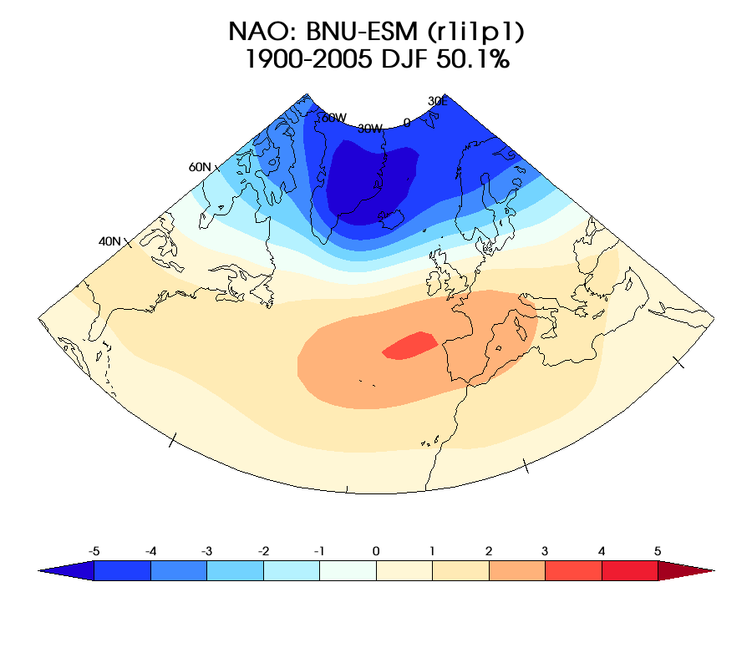
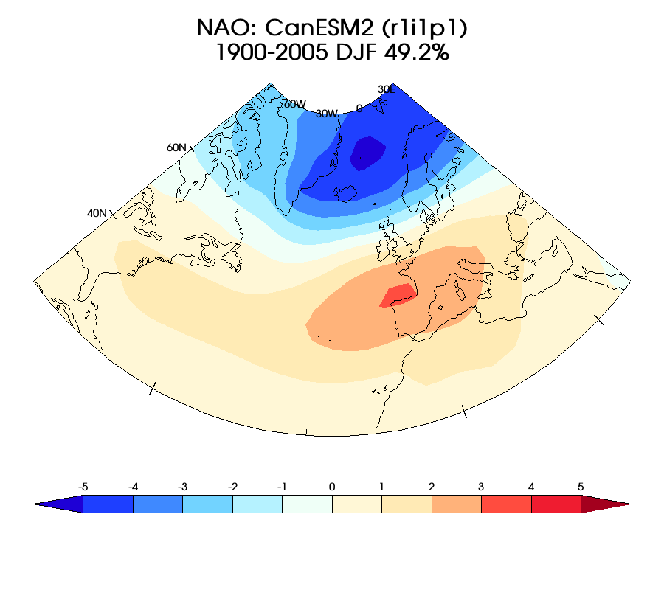
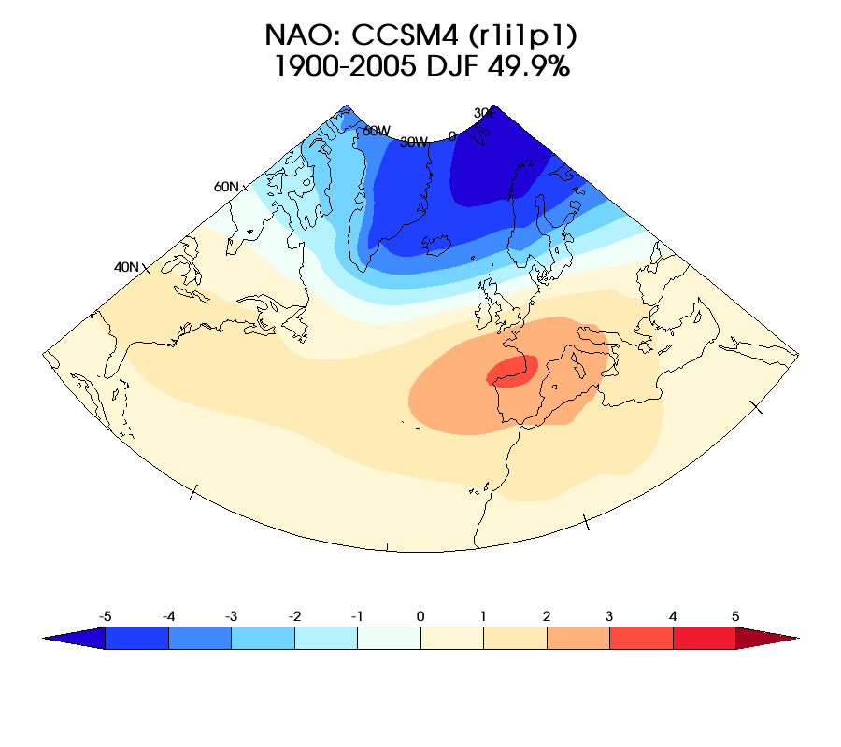
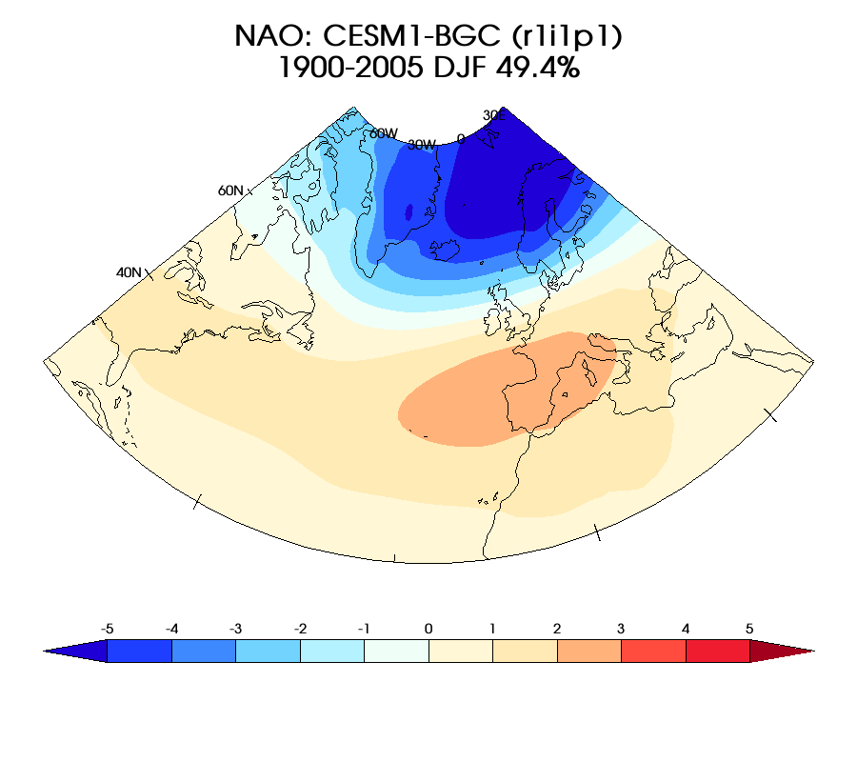
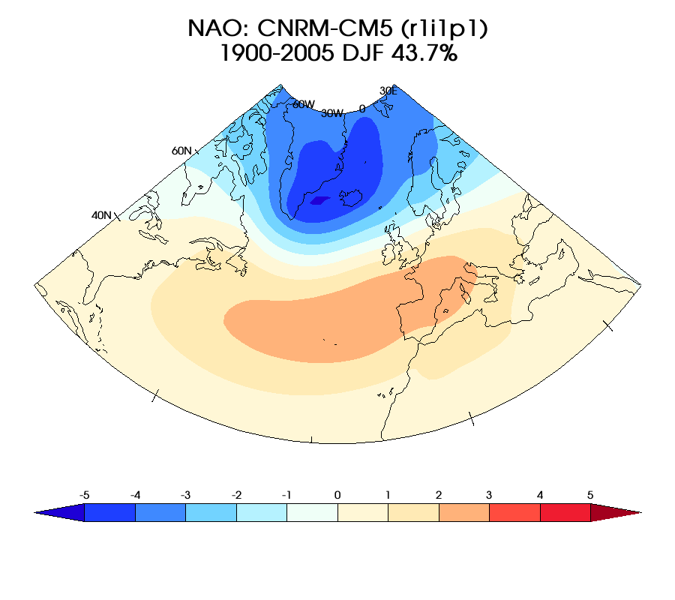
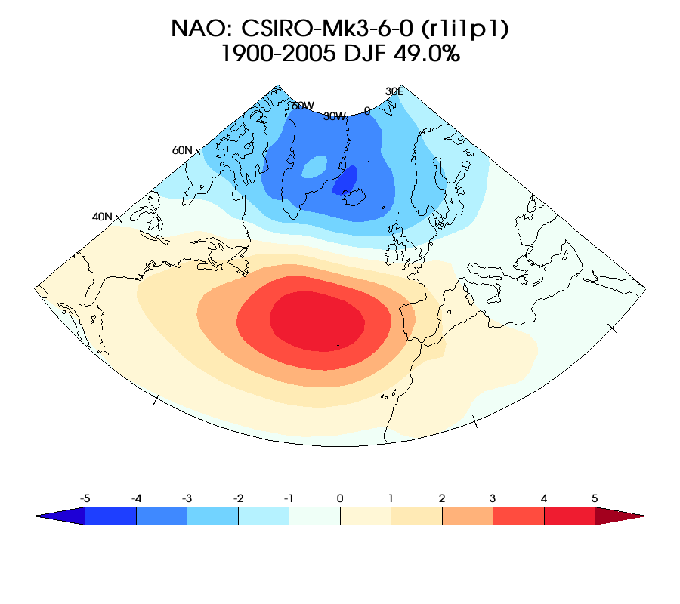
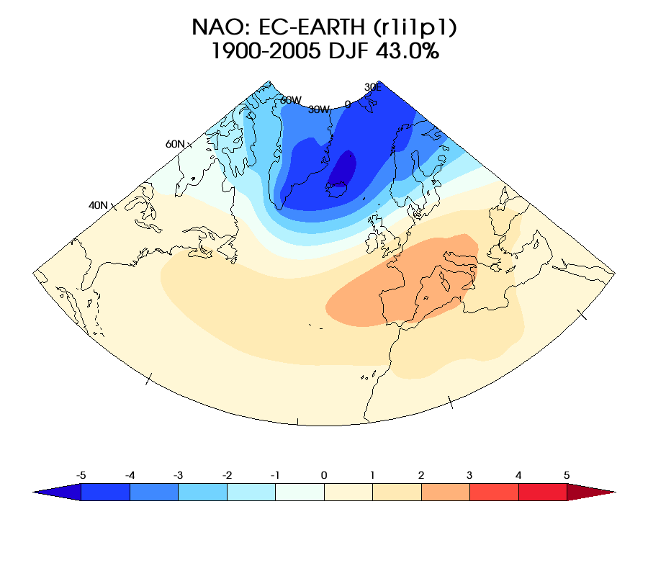
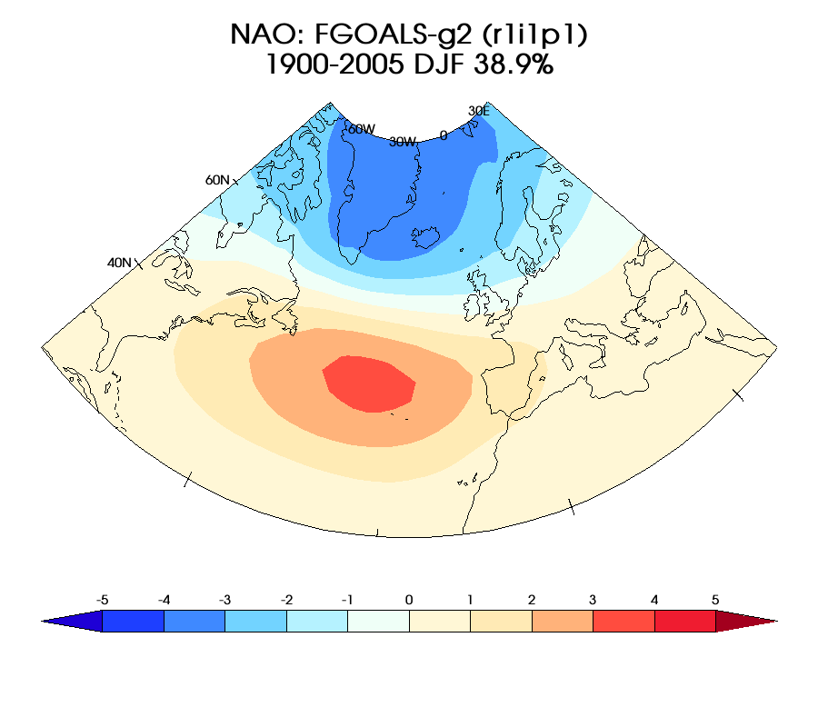
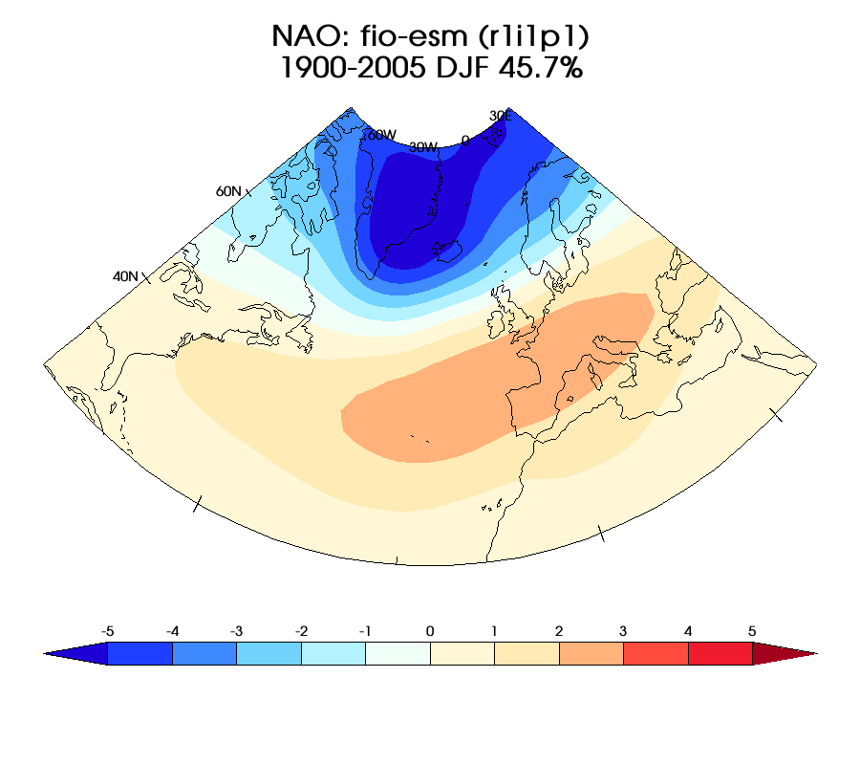
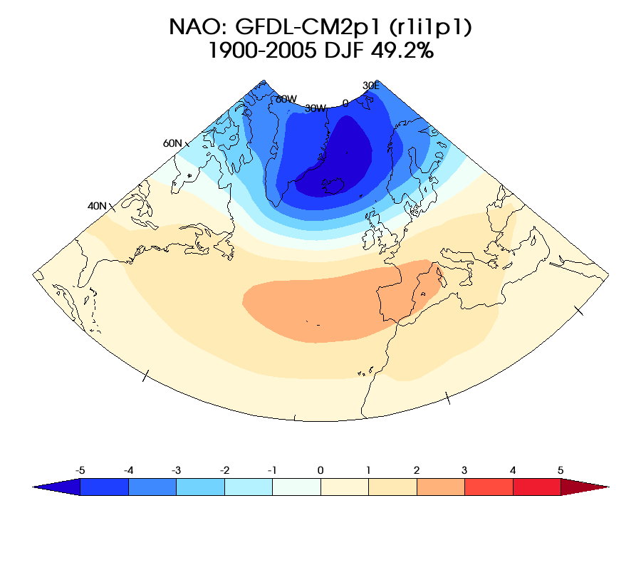
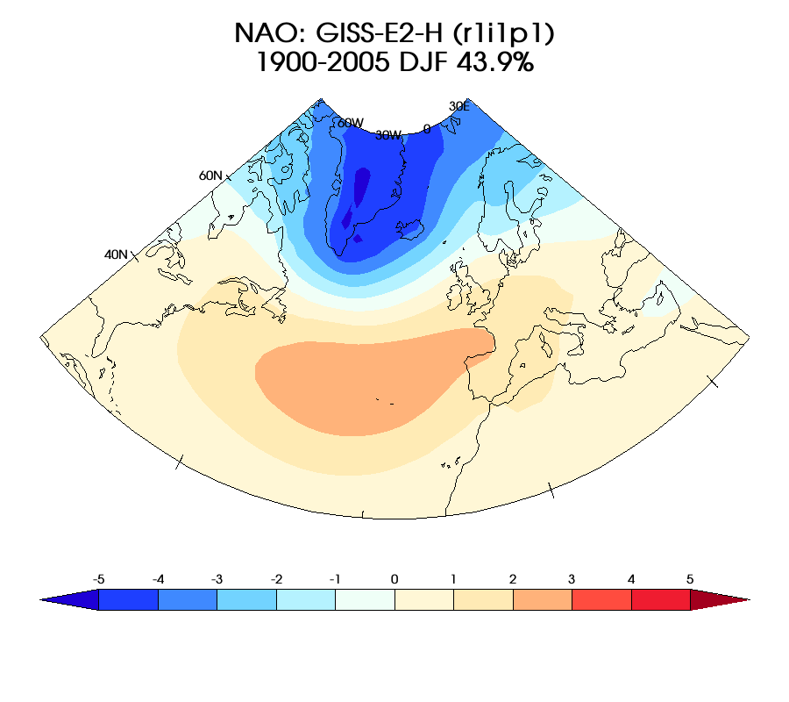
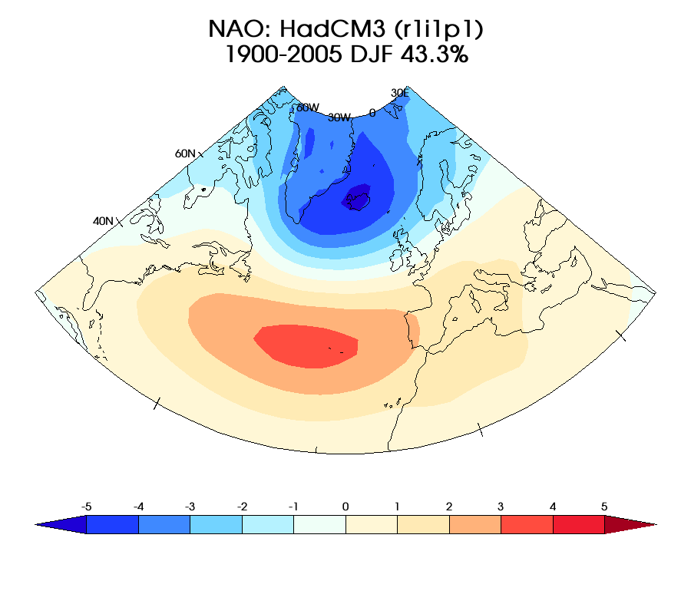
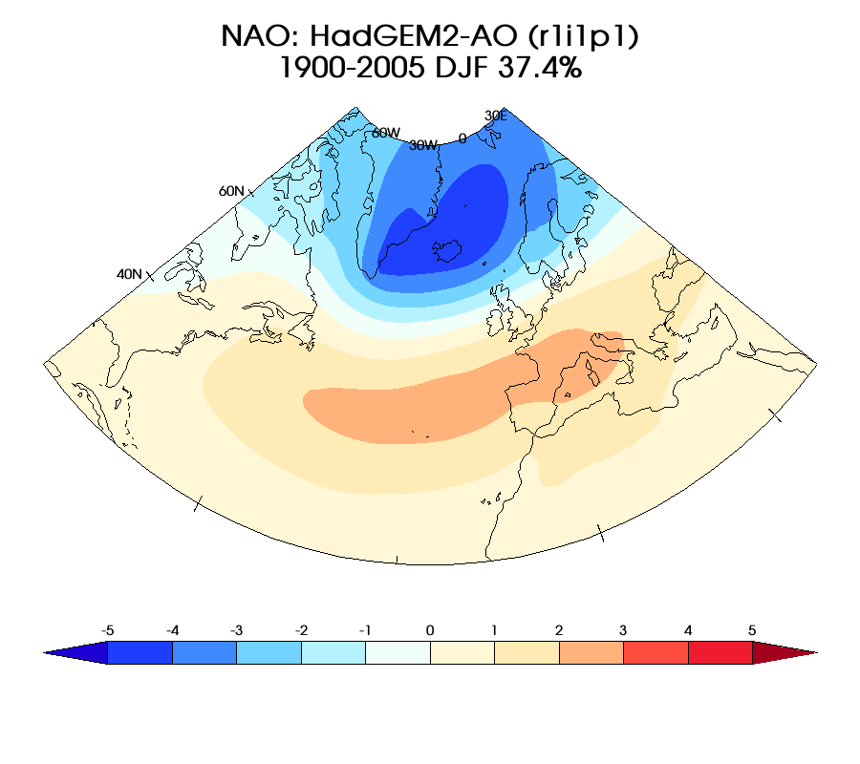
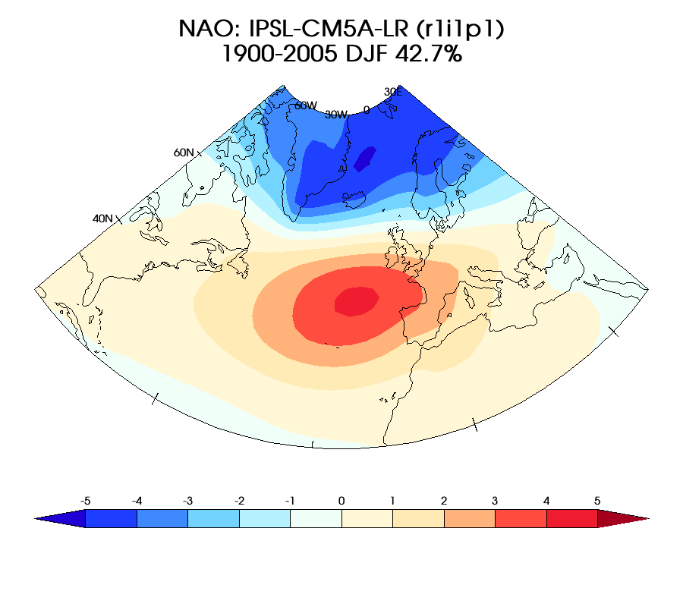
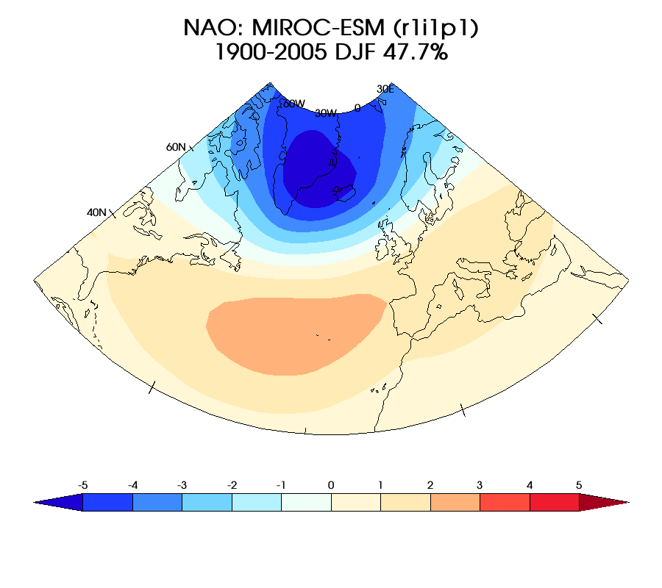
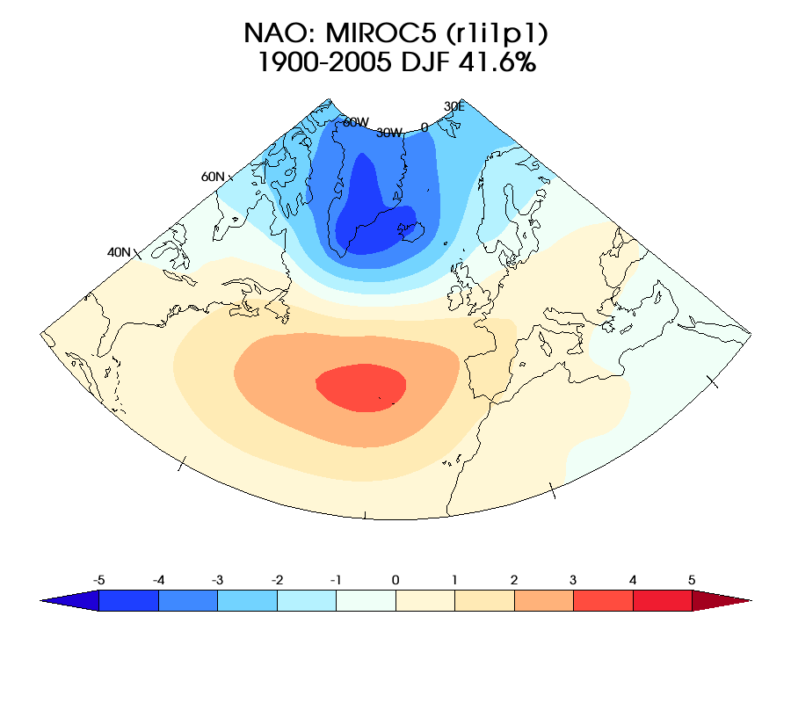
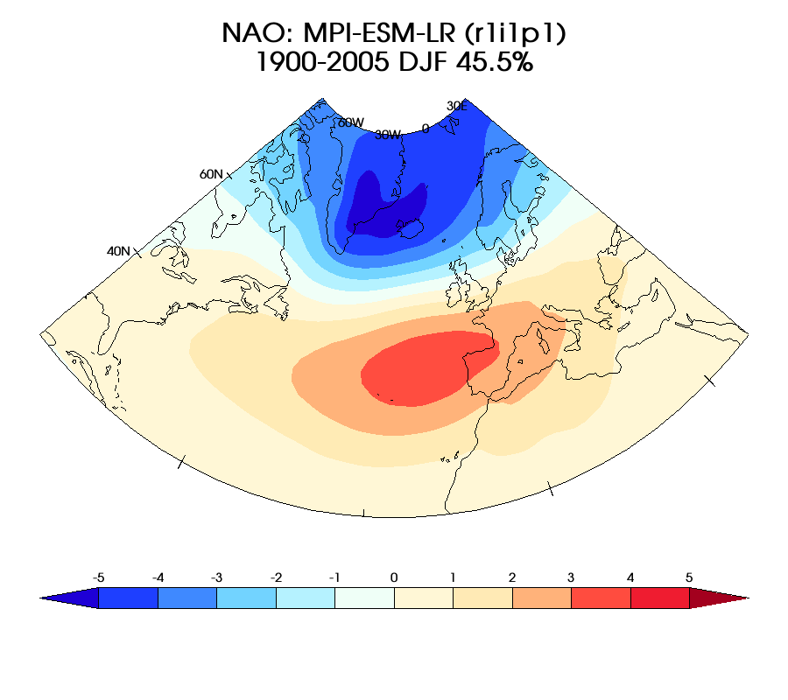
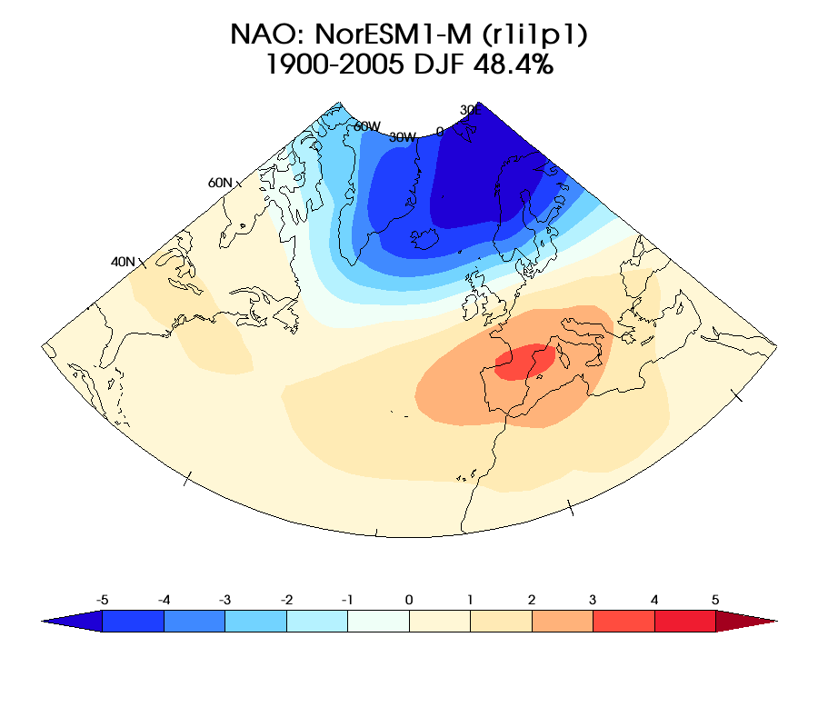
Typical Scientist’s Workflow
New Data
Exploratory Phase
Hypothesis
Run Diagnostics
Mass Production
Peer Review
Publication

Slide 3

Community Data Analysis Tools
Python-based
Lots of books
Easy coupling with other languages
Python 2 (Python 3 due)
One environment to rule them all
cdms+vcs+cdutil+genutil+….
Bring Code To The Data

Slide 4


Obtaining and Integrating CDAT
Used to be an obstacle, but no longer.
conda create –n myenv uvcdat –c conda-forge –c uvcdat
Since last year port to anaconda:
~3000 uv-cdat downloads since moving to conda last year
~7000 cdms2 downloads
Mac and Linux support
Code open-sourced on GitHub.
For more complex environments like ESGF compute nodes, this needs to be coupled with a Docker distribution

Slide 5
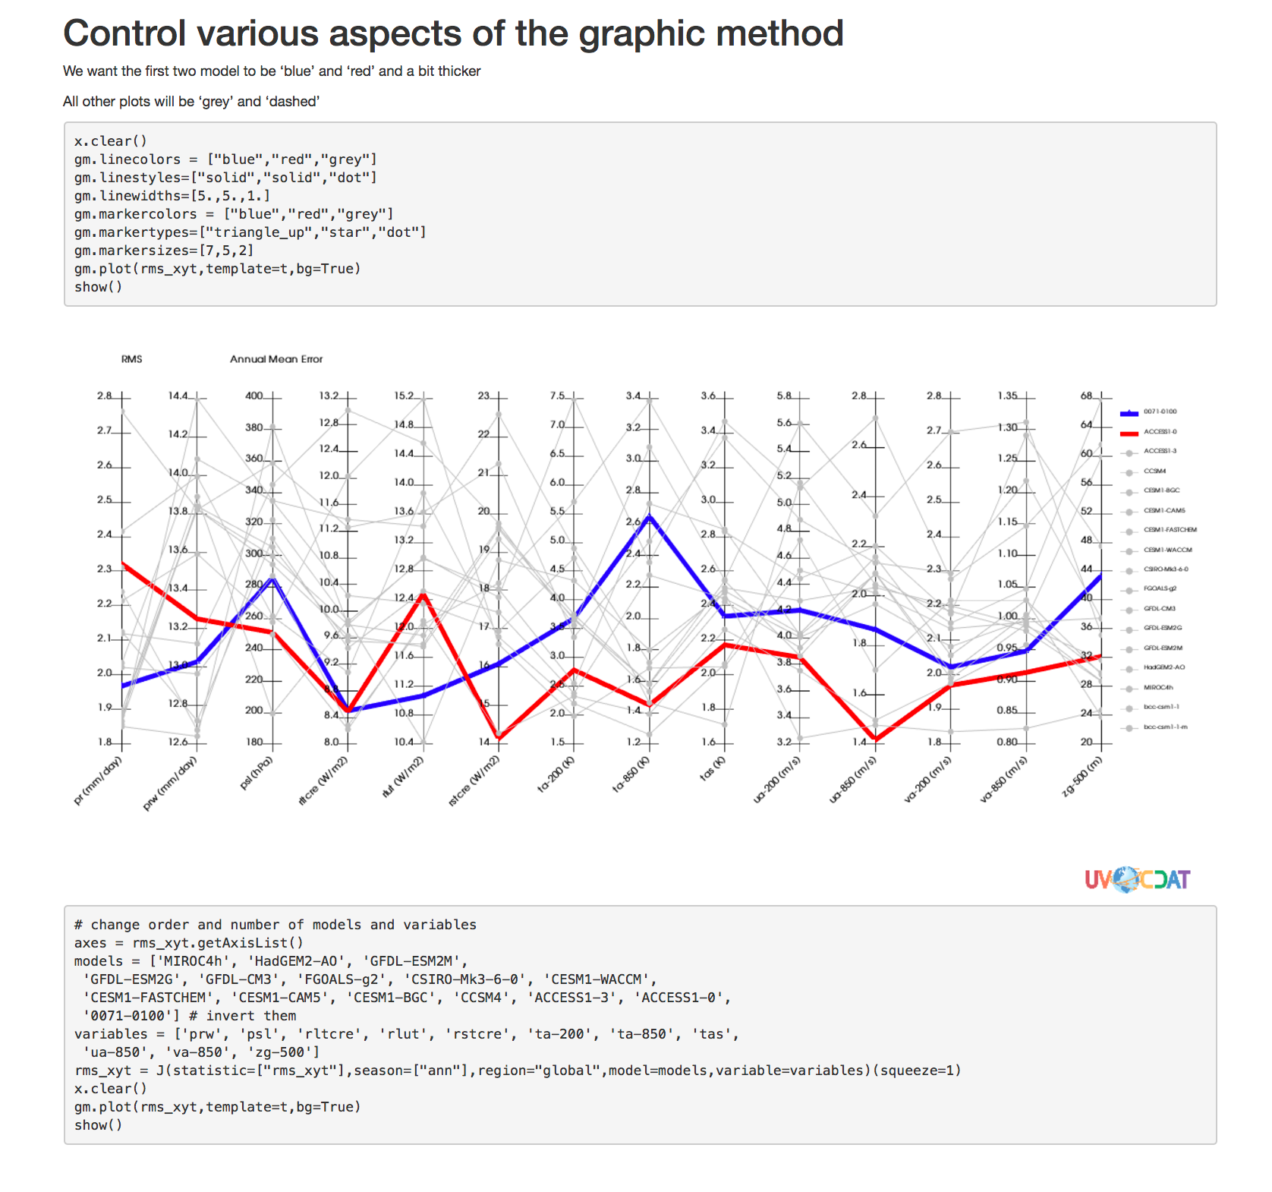


Documentation (ongoing)
In-code documentation, integrated with test suites to ensure code is working and relevant
Gallery: https://uvcdat.llnl.gov/gallery.html
Jupyter notebooks: https://uvcdat.llnl.gov/tutorials.html
You tube videos:
Mailing list (overnight response):
Users list: uvcdat-support@llnl.gov
Developers list: uvcdat-devel@llnl.gov
Github issues: http://github.com/uv-cdat/issues
Hours to a week turn around for regular bugs to be fixed and in nightly
Posted on read the docs which generates user documentation

Slide 6
Using CDAT (scripting vs VCDAT)
Because it is based on a language not a closed box, the possibilities are nearly endless
Need to be able to start learning quicker via a web-based GUI (VCDAT)
Integrated with other ESGF services like COG and CWT

Slide 7



Loading Data
I/O done via Community Data Management System (CDMS)
Support multiple file formats (NetCDF, Grib, PP, etc…)
Data structure on top of C-implemented NumPy
Flexible enough to add new format, back ends and technologies (Dask, Numba,…)
Understand and takes advantage of CF conventions

Slide 8
Persistent metadata
Provenance

Slide 9





Analyzing Data
In addition to the many Python-ready analysis packages (Rpy, SciPy, …)
Regridding Tools (ESMpy, libcf, area weighted)
Genutil and Cdutil
developed in collaboration with ESGF users, tailored toward Climate science
Metadata smart
High Performance tools and technics available: MPI, Spark

Slide 10
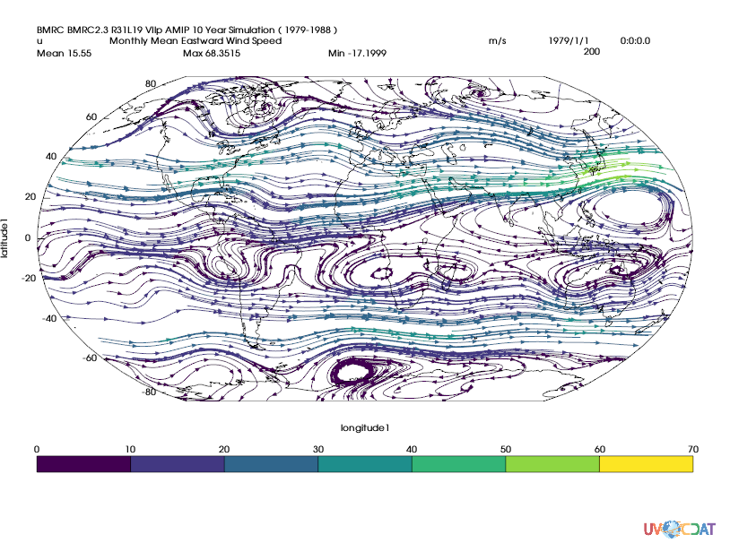
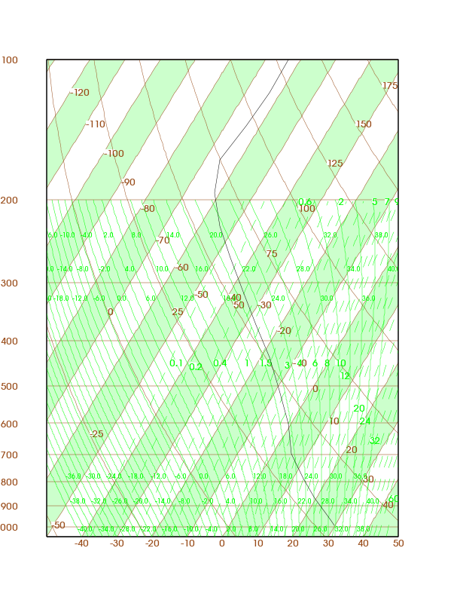
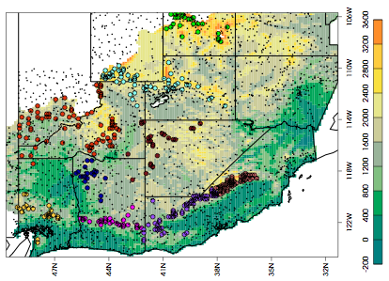
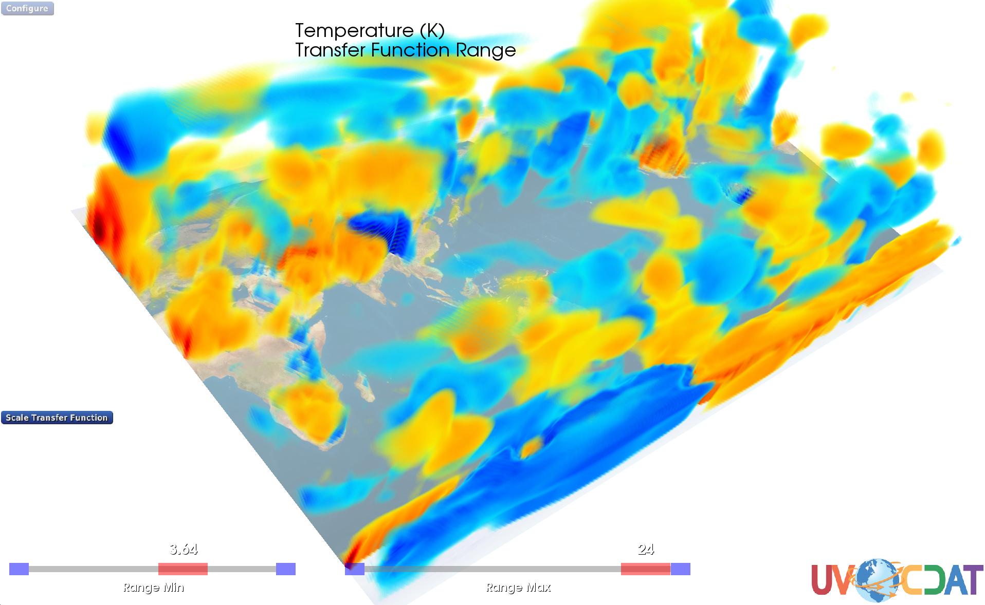
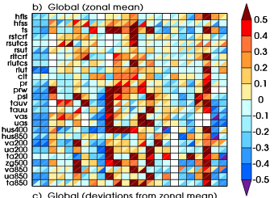
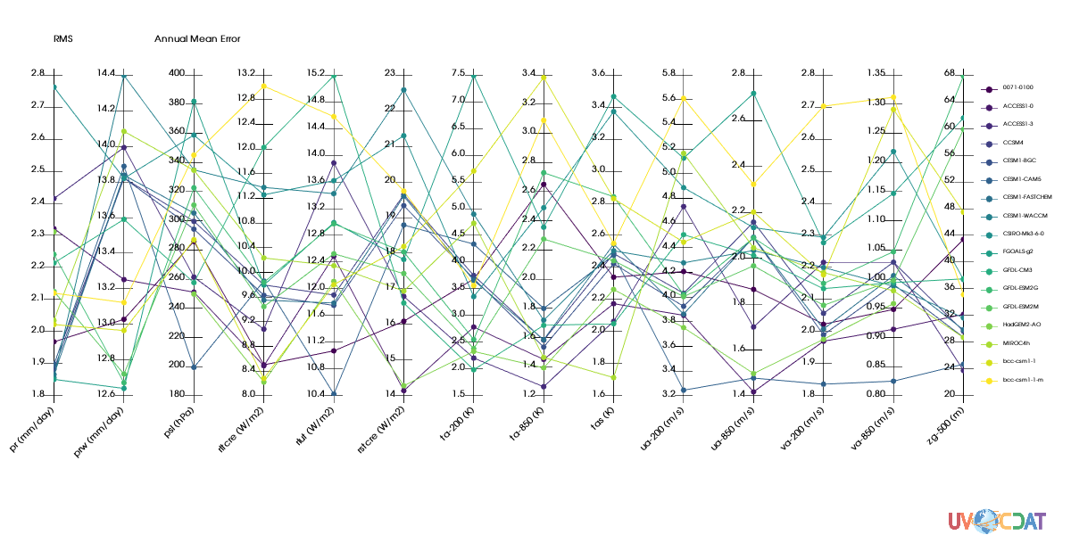
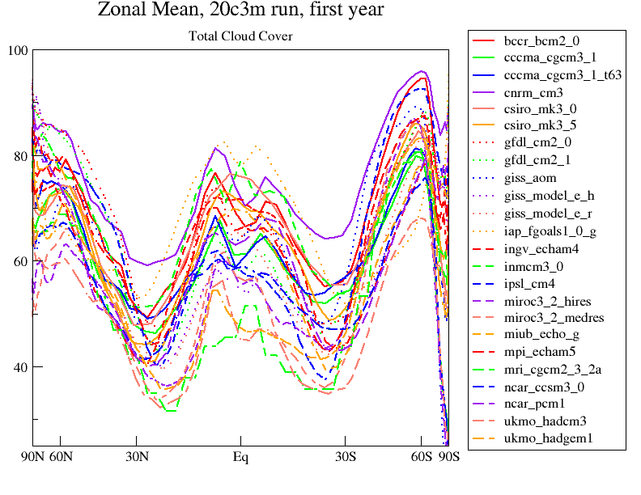
Visualizing Data
1D, 2D, 3D
Based on top of VTK.
Metadata-smart so no need to create grids, earth science ready out of the box
Adding new visualization
Swappable backend design keeps system flexible and adaptable to new technologies

Slide 11
Future/Exploratory Work
ESGF Server-side integration
Provenance (researching dask)
In-situ analysis
high frequency data that won’t be saved
Instruments (obs4mips)
GIS integration
CPU and GPU cluster integration (for CWT and VCDAT)

Slide 12
Summary
Feature | Available
Easy Install | Y
Docker | F
Linux | Y
Mac | Y
Windows | F
Live Online Documentation | F
Inline Documentation | Y
Tutorials | Y/F
Browser-based (VCDAT) | F
Multiple Input Format | Y
Extendable and Flexible | Y
Community Compatible | Y
Metadata Aware and Persistent | Y
Provenance | F
Server Side Analysis | F
Regridder | Y
CPU Cluster | F
GPU Cluster | F
Projection | Y
GIS | F
Y – Yes
F – Future work

